Slide 1
COVID-19 Database Analysis
A report on cases in the UK, France, and Italy
Patrick Smelt, Joe Lis, Robert Grenda, Jerek Stegman

Slide 2
Project Overview
Goal: Design a data warehouse to support epidemiological analysis using data from Project Tycho
Application domain: Public health monitoring of COVID-19 across France, Italy, and United Kingdom
Tools: SQL, Kafka, Docker, Python, phpMyAdmin

Slide 3
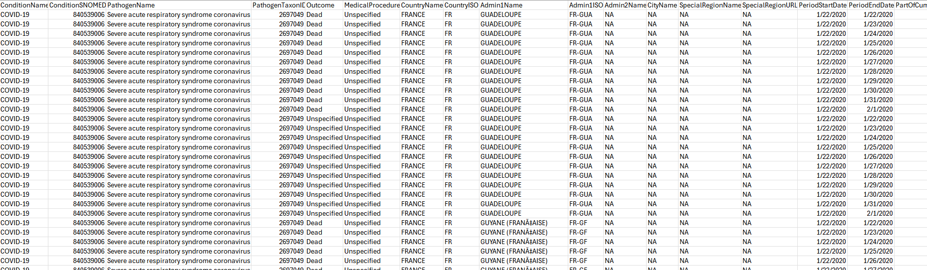
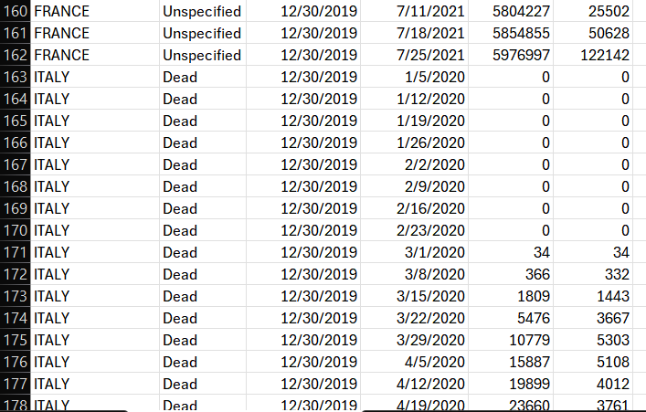
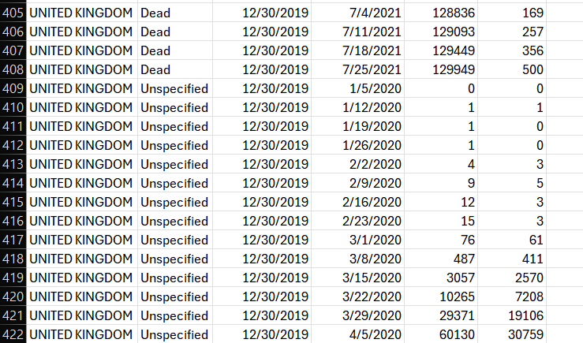
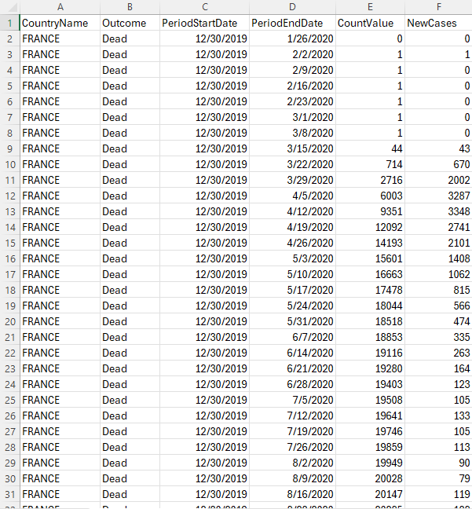
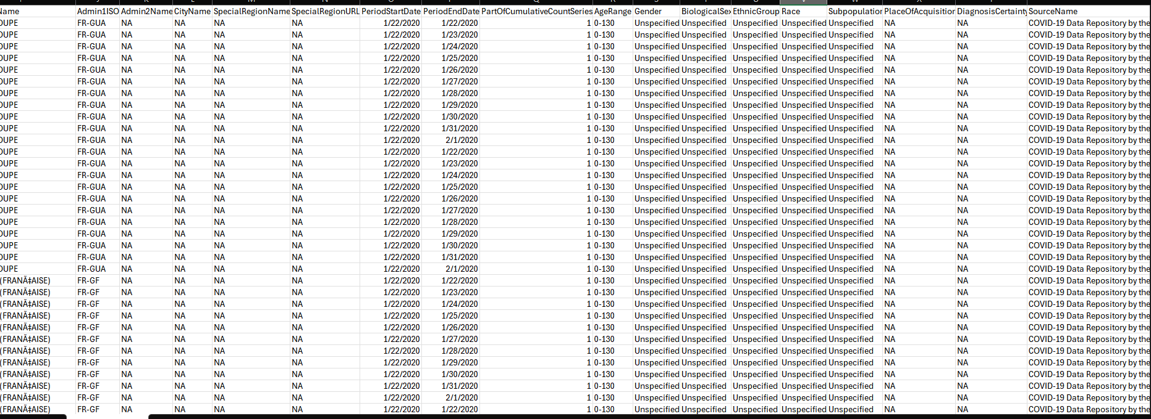
Data Description
Weekly epidemiological reports of Covid-19
Primary attributes:
outcome
(Dead, Unspecified)
count_value
(Cumulative)
Other attributes:
country_id
time_id
new_cases
(Changes from previous week)
Supports multidimensional analysis
Trend-tracking
Public health decision making
Regional comparisons
Notes:
Initially had a mess of data - many incomplete or just useless columns
Also had to deal with data from the country’s dependencies and territories
It initially had daily data, went with weekly data because it aligned more with what queries we were going to be performing
We also lacked week-by-week new cases - had to create a new column for this
Data was also in three different files - combined into one for ease of access
Ended up with week-by-week data, sorted by week and country, split by Dead or “Unspecified” (total cases)

Slide 4
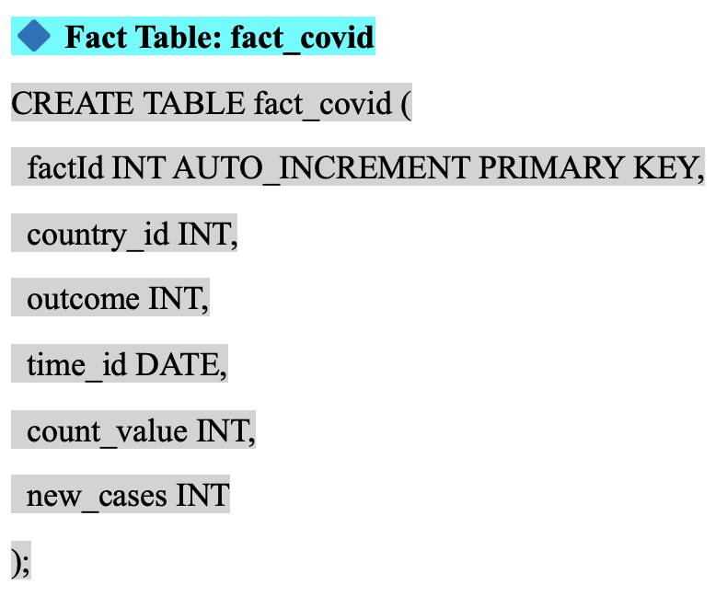
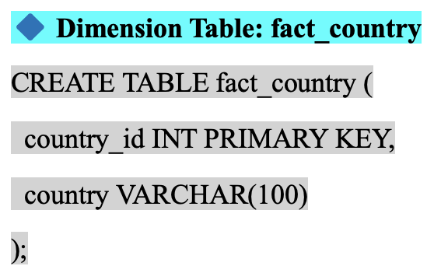
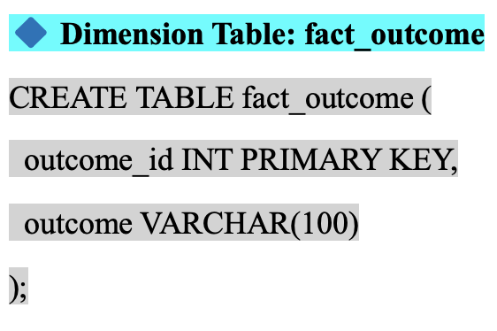
Star Schema
We implemented a simplified STAR schema with one fact table and two dimension tables:
These tables were populated via direct inserts and during data pipeline execution.

Slide 5
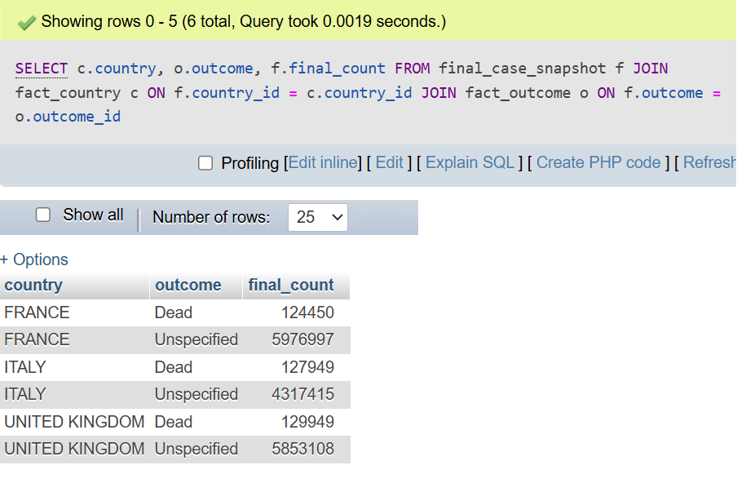
OLAP Queries
Final case snapshot by Country and Outcome

Slide 6
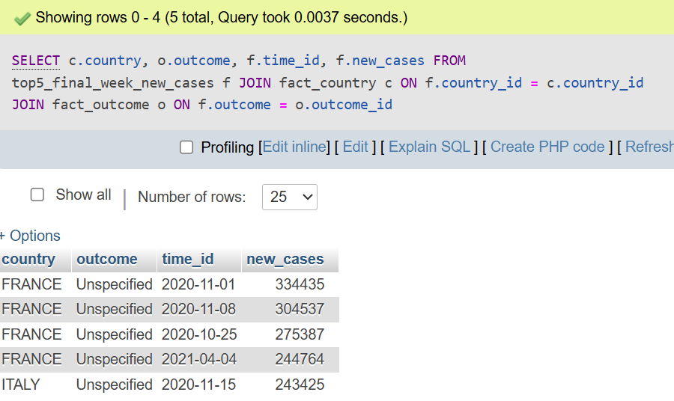
OLAP Queries
2. Display the top 5 country-outcome combinations with the highest number of newly reported cases in a single week.

Slide 7
OLAP Queries
3. Aggregates total cumulative cases per month, grouped by country and outcome type. Great for analyzing Long-term trends.

Slide 8
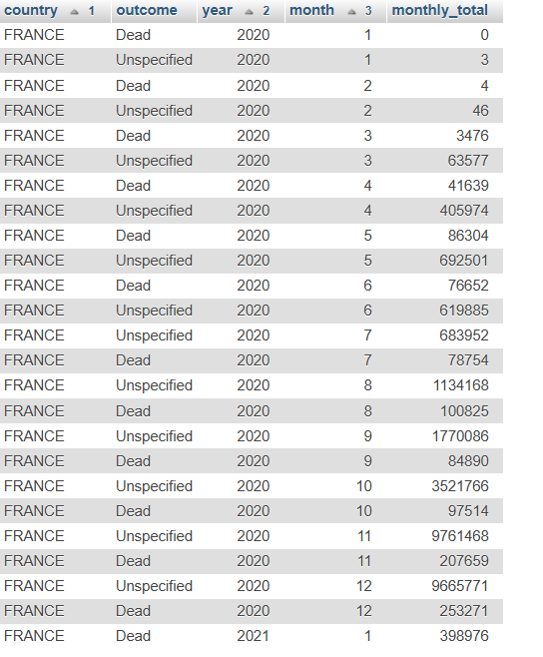
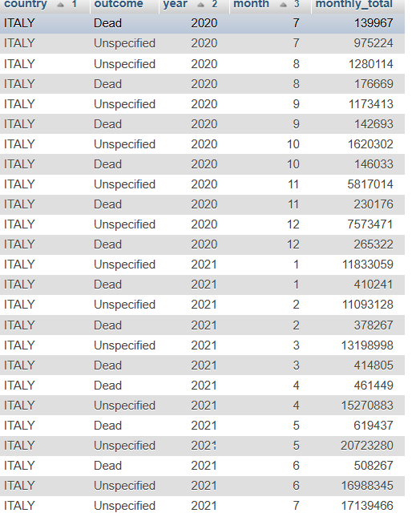
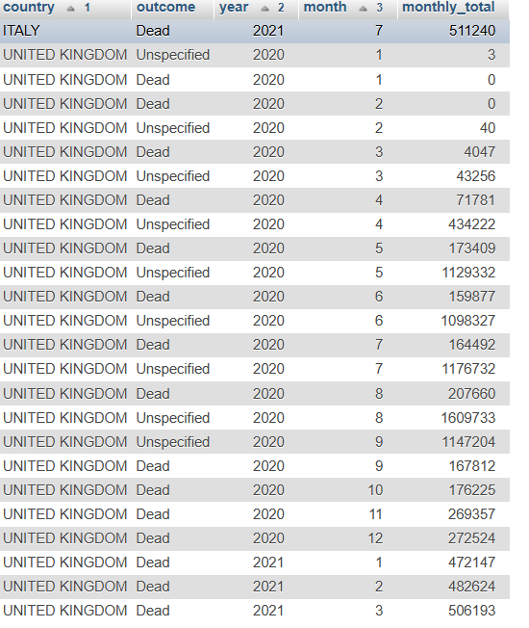
Query 3 Output

Slide 9
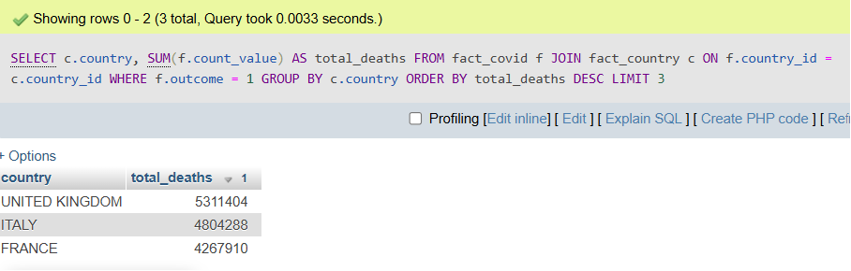
OLAP Queries
4. Calculates total deaths per country across all time and shows the total deaths per each country.

Slide 10
Challenges
Data standardization
Combining each dataset (France, Italy, UK) required cleaning
(E.g. converting MM/DD/YYYY to YYYY/MM/DD)
Missing data complicated cleaning and aggregation
Docker configuration
Managing multiple containers (Eg. MySQL servers, Kafka, etc.) created challenges with port conflicts
Creating new data
Had to implement a column for new cases by week using SQL

Slide 11
Conclusion
Accomplished creating a large data warehouse
Use of a STAR schema to support COVID-19 analysis
Implemented real-time data integration with Kafka and Docker
Created and ran executable OLAP queries on the data warehouse
Insights gained can aid in public health monitoring and future decision making

